Slide 1

Hadoop Implementation for Bigdata Analysis
© Nihilent Technologies 2013

Slide 2
Agenda
Agenda
Overview of Hadoop : Introduction
Hadoop Architecture
Hadoop – MongoDB Architecture: Frontend Integration
- Tumbhi with Hadoop
- Architecture
Bigdata Integration and Reporting
  - Hive - Pentaho integration Architecture
- Reports
Conclusion
© Nihilent Technologies 2013

Slide 3
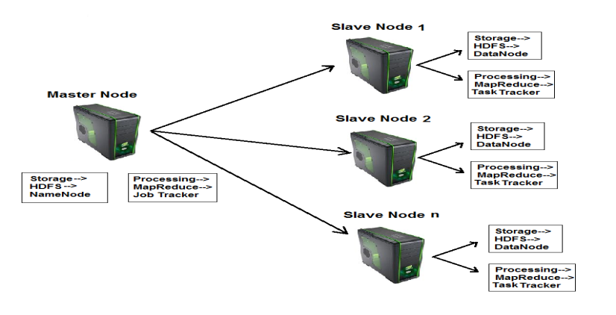
Agenda
Overview of Hadoop : Introduction
Hadoop is a framework that facilitates functioning of several machines together to achieve the goal of storage and analyzing large sets of data.
Hadoop makes data mining, analytics, and processing of
big data cheap and fast.
Hadoop consists of two core components
1. The Hadoop Distributed File System(HDFS)
- HDFS is responsible for storing data on
the cluster of machines.
- Data is normally split into 64MB to 128MB blocks and spread across the cluster.
2. MapReduce
      - MapReduce is data processing component of Hadoop.
      - Consist of two phases :
      1. Map
      2. Reduce
© Nihilent Technologies 2013

Slide 4
Tumbhi : Existing and Proposed
 | Existing | Proposed
Recommendation Engine | No | Collaborative Filtering(User-user and Item-item) based Algorithms to give most likely recommendations.
Analytical Reporting | Google Analytics for reporting, but do not have customized reporting. | Hive-Pentaho integration for reports, can generate slandered as well as custom of report from the application logs and database tables.
Storage | MySQL Server (Structured), File Server, CDN, CMS (Unstructured) | Single source of storage(Structured + Unstructured). HDFS or MongoDB for structured and unstructured data, Hive for data warehousing and Reporting.
Search | Apache Solr on top of MySQL server. | MongoDB stores data with key value pairs, so searching is by default faster. Scale up to petabytes of data.
© Nihilent Technologies 2013

Slide 5
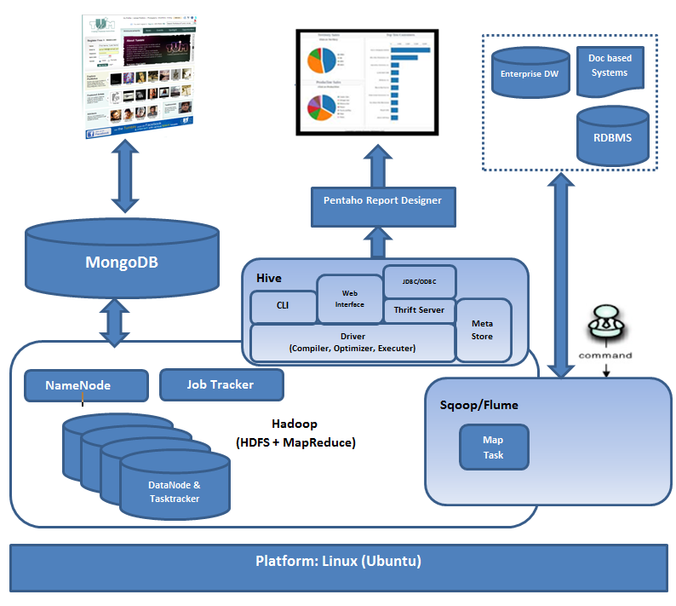
Bigdata-Hadoop Architecture :

Slide 6
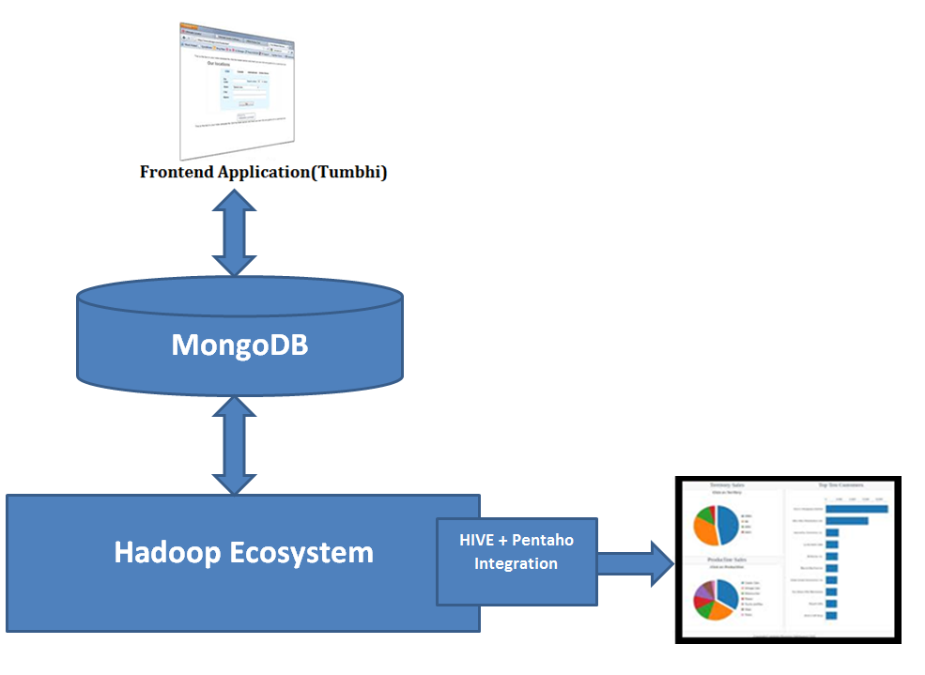
Hadoop Architecture: Frontend Integration
MongoDB : Real-time integration
Pentaho : BI and Reporting
Hadoop Ecosystem : Data analysis,
Processing and Storage
© Nihilent Technologies 2013

Slide 7
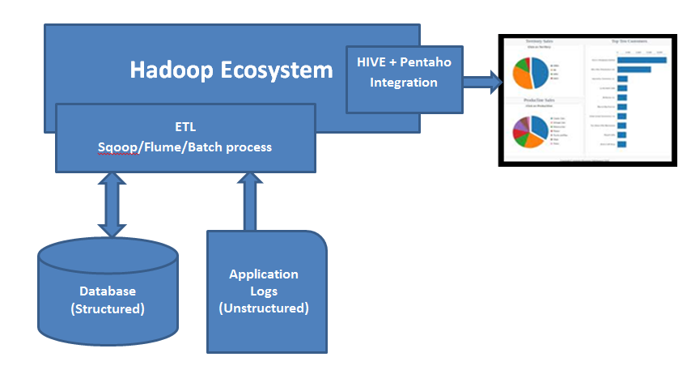
Bigdata Analytics :Web Traffic Reporting
Analytical reports from Application Logs(Unstructured data) and Database tables.
© Nihilent Technologies 2013

Slide 8
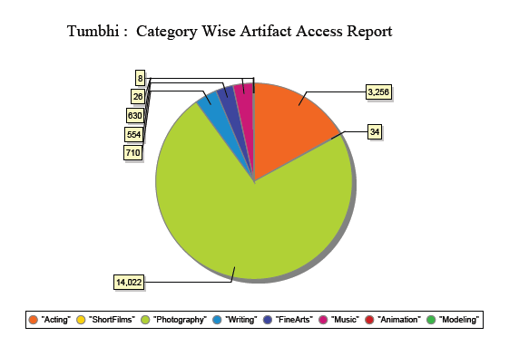
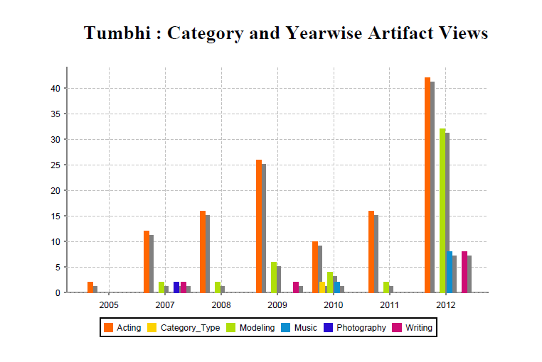
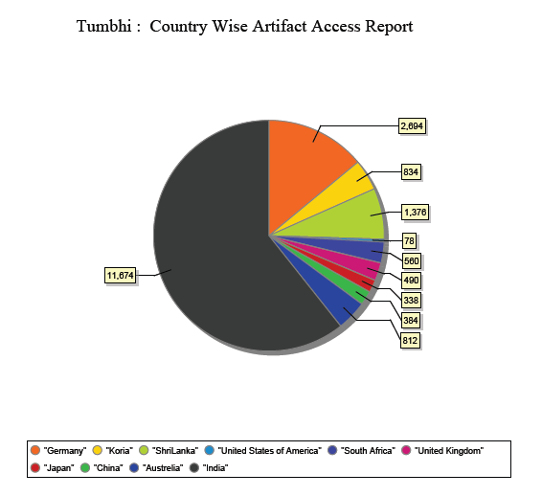
Web Traffic Reporting
© Nihilent Technologies 2013

Slide 9
Conclusion
Cost effective & scalable solution
Social media Integration to predict customer trends, patterns and its recommendations
User/Item based recommendations
To generate Web site traffic Analytical reports for business users to predict the customer trends, patterns and to focus on necessary business areas for promotions/campaigning.
© Nihilent Technologies 2013

Slide 10
Thank you!
© Nihilent Technologies 2013

